Slide 1
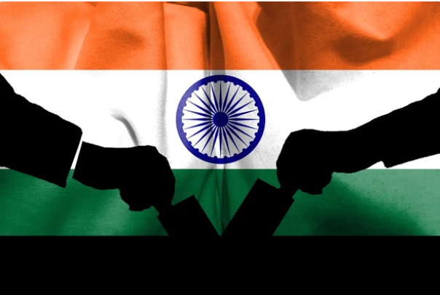

Election Results Analysis 2024
By – Shivangi Gupta

Slide 2
Election Results Analysis 2024
By – Shivangi Gupta

Slide 3
Agenda
Objective
Dataset Description
Data Integration
Data Cleaning and Preparation
Key Performance Indicators (KPIs)
Top 10 Leading Parties
State-wise Analysis
Constituency-wise Analysis
Party and Alliance Comparison
Trend Analysis
Distribution Of Seats by each Party.
Distribution of Seats by each Alliance.
Interactive Dashboard
Insights and Recommendations

Slide 4
Objective
The goal of this analysis
To examine the 2024 election data to gain insights into the election results
Party performance
Voter trends across various constituencies.
Using Power BI, we'll create interactive visualizations and dashboards to help stakeholders understand the election outcomes and the dynamics between different political alliances.

Slide 5
Dataset Description
Election Results Data:
Id: Unique identifier for each record.
State: Name of the state.
Const. No.: Constituency number.
Constituency: Name of the constituency.
Leading Candidate: Name of the leading candidate.
Leading Party: Name of the leading party.
Trailing Candidate: Name of the trailing candidate.
Trailing Party: Name of the trailing party.
Margin: Vote margin between the leading and trailing candidates.
Status: Status of the election result.
Party Alliance Data:
Party Name: Name of the political party.
Alliance Name: Name of the political alliance the party belongs to.

Slide 6
Data Integration
Data Sources:
Election Results Dataset
Party Alliance Dataset.
Integration Method:
VLOOKUP for combining datasets based on Leading Party and Trailing Party.
Created two columns Alliance of Leading Party and Alliance of Trailing Party.

Slide 7
Data Cleaning and Preparation
Removed duplicates rows in the dataset.
Changed datatype where necessary for better data handling.
Removed rows where status was "uncontested" to maintain data integrity.
Eliminated the "Status" column as it only contained the value "Result Declared".
Cleaned and trimmed categorical columns for consistency and accuracy.
Capitalized categorical column entries using appropriate functions for uniformity.
Created calculated measure- Alliance by leading Party, First Leading Party, Seats Won Constituencies Won by Alliance

Slide 8
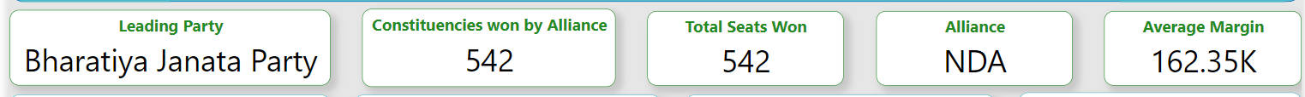
Key Performance Indicators (KPIs)
Significance
Leading Party: Highlight the party with the highest number of wins.
Constituencies Won by Alliance: Emphasize the most successful alliance.
Total Seats Won: Show the overall distribution of seats.
Average Margin: Discuss the competitiveness of the elections based on average margins

Slide 9
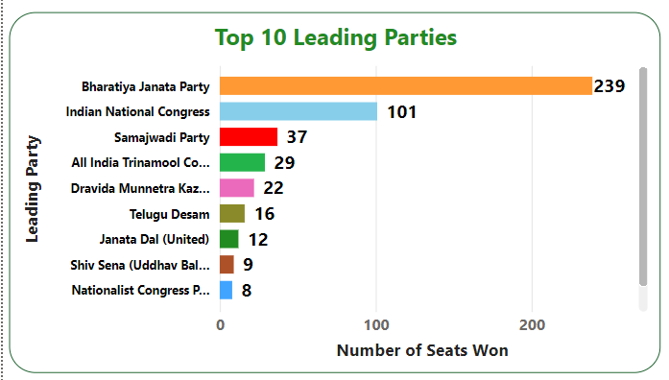
Top 10 Leading Parties
Bharatiya Janata Party (BJP) secured the highest number of seats in the election, winning 239 seats.
Indian National Congress followed closely with 101 seats, making it the second-highest winning party.
There was significant competition among other parties for the remaining top positions.
Shiv Sena obtained the lowest number of seats among the top 10 leading parties.

Slide 10
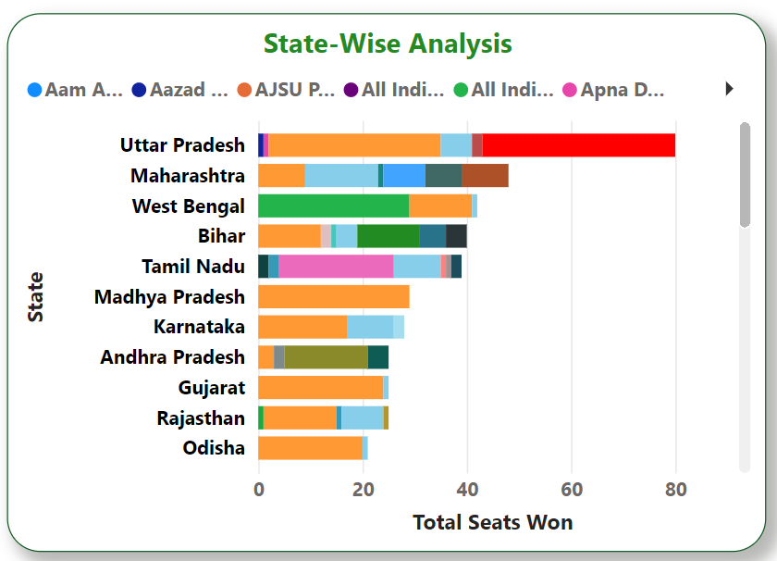
State-wise Analysis
Uttar Pradesh:
Highest competition between BJP and Samajwadi Party.
Samajwadi Party dominates with significant influence.
Uttar Pradesh accounts for 90 seats.
Maharashtra:
Second-highest competition observed.
Sikkim:
Lowest competition observed among constituencies.
Minimal electoral variability due to unique regional factors.

Slide 11
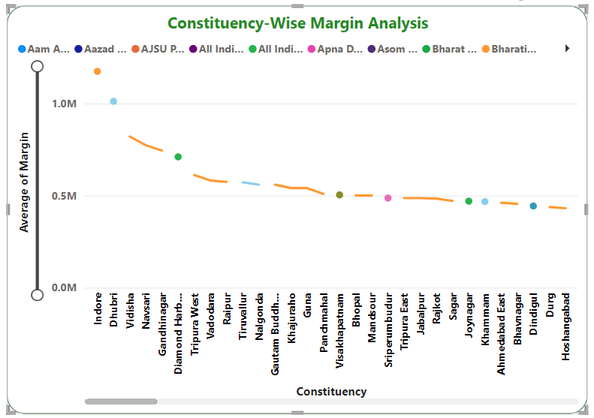
Constituency-wise Analysis
BJP Dominance:
Demonstrated significant dominance in Indore and Vidisha constituencies.
Congress Dominance:
Exhibited strong performance in Dhubri constituency.

Slide 12
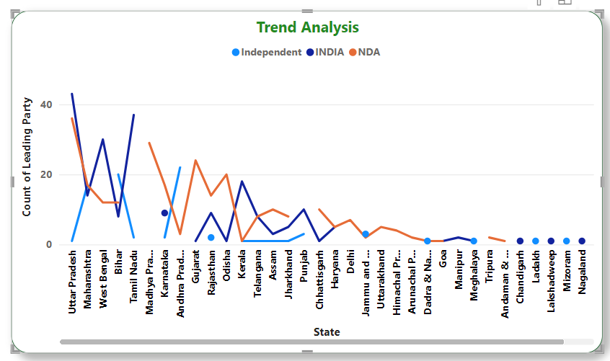
Trend Analysis
Alliance “INDIA”: Initially strong in early states, but experiences a sharp decline.
Alliance “ NDA” : Initially strong but gradually decreases in later states.
Alliance “Independent” : Initially strong but experiences a sharp decline.
Regional Patterns:
Uttar Pradesh- High Voting activity
Maharashtra- Moderate fluctuations.
West Bengal- Consistent Performance.
Bihar- Steady Decline.

Slide 13
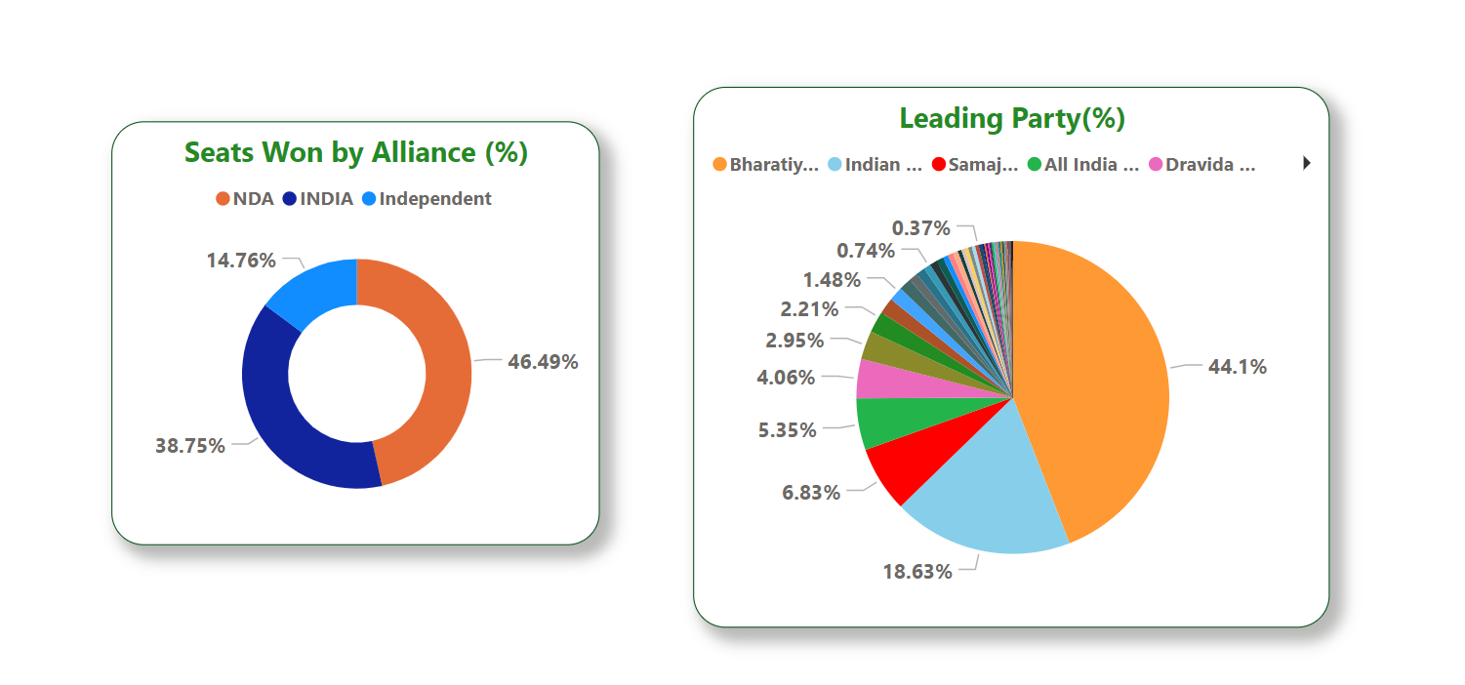
Distribution Of Seats by each Alliance
NDA:
Won the highest number of seats overall, securing 46.49%.
INDIA:
Secured 38.75% of the seats.
Independent:
Achieved 14.76% of the seats.

Slide 14
Distribution Of Seats by Each Party
Bharatiya Janata Party:
Secured the highest percentage of seats at 44.1%.
Indian National Congress:
Followed closely, winning 18.63% of the seats.
Other Parties:
Each won less than 5% of the seats across all states.

Slide 15
Interactive Dashboard

Slide 16
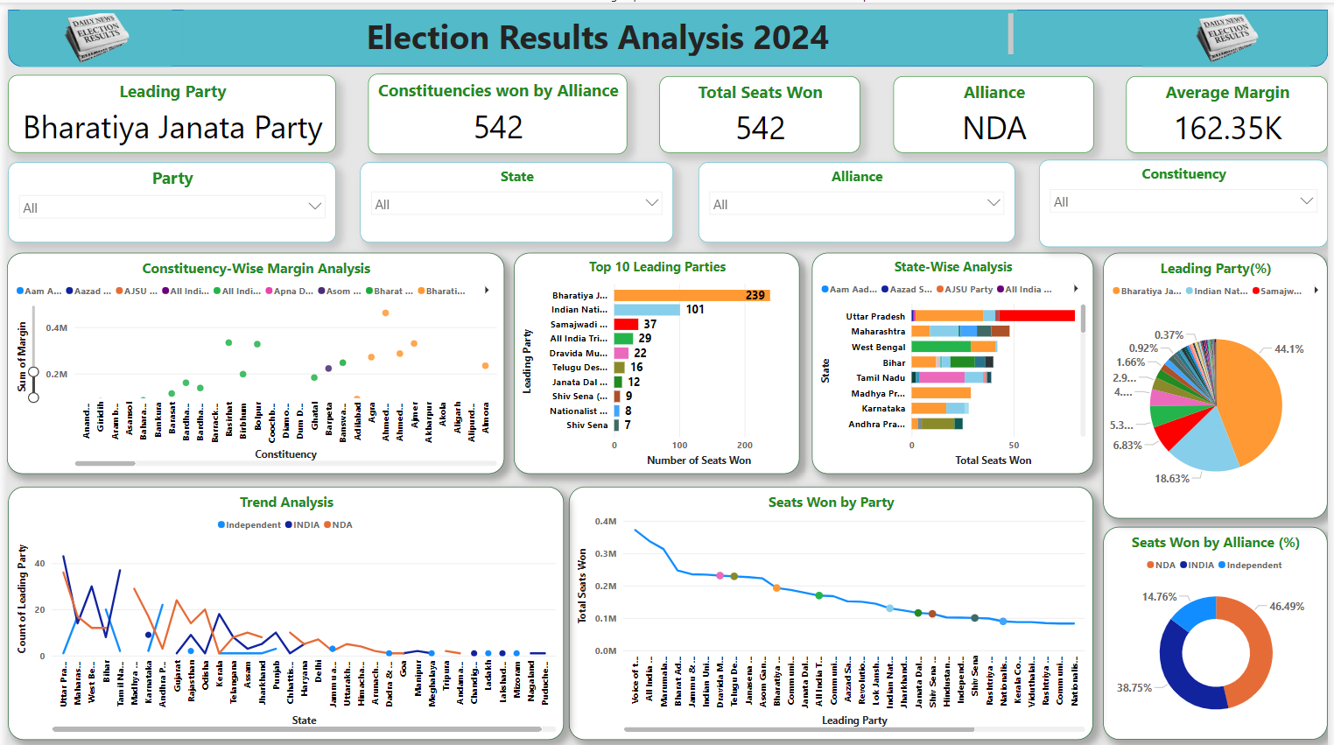

Slide 17
Insights(1/2)
Bharatiya Janata Party (BJP) (NDA)
Secured the highest number of seats: 239.
Dominance in Indore and Vidisha constituencies.
Highest percentage of seats at 44.1%.
Indian National Congress (INDIA)
Won 101 seats, the second-highest.
Strong performance in Dhubri constituency.
Secured 18.63% of the seats.
Competition Analysis
Uttar Pradesh: Highest competition between BJP and Samajwadi Party.
Maharashtra: Second-highest competition observed.
Sikkim: Lowest competition among constituencies.

Slide 18
Insights(2/2)
Alliance Performance
NDA: Won the highest number of seats overall, 46.49%.
INDIA: Initially strong but experiences a sharp decline, securing 38.75%.
Independent: Initially strong but experiences a sharp decline, achieving 14.76%.
Regional Voting Patterns
Uttar Pradesh: High voting activity.
Maharashtra: Moderate fluctuations.
West Bengal: Consistent performance.
Bihar: Steady decline.

Slide 19
Recommendations
For Leading Parties:
Maintain dominance in key constituencies.
Continue employing successful strategies in high-performing regions.
For Trailing Parties:
Analyze areas of weakness to identify improvement opportunities.
Re-strategize campaigns to target competitive regions.
Strategic Focus:
Concentrate on regions with narrow margins to sway undecided voters.
Regional Campaigns:
Tailor campaigns to address state-specific issues and voter concerns.
Alliance Strengthening:
Strengthen alliances to maximize voter reach and consolidate support in key constituencies.

Slide 20
Thank You. . .

